Slide 1
Multiplicative relationships in circles
Perimeter, area and volume

Slide 2
how to use Oak lessons

Slide 3
I can recognise that there is a constant multiplicative relationship (π) between the diameter and circumference of a circle.

Slide 4
The circumference of a circle is the perimeter of the circle.
The radius is any line segment that joins the centre of a circle to its edge.
The diameter of a circle is any line segment that starts and ends on the edge of the circle and passes through the centre.

Slide 5

Multiplicative relationships in circles
Parts of a circle
The relationship between circumference and diameter

Slide 6
Parts of a circle
A circle can be described based on its parts.
The circumference of a circle is the distance around its edge.
Circumference is a word used for the perimeter of a curved shape.
circumference
circumference

Slide 7
Parts of a circle
A circle is a shape such that every point on the circumference is equidistant to its centre.
circle
not a circle
a = b
a ≠ b
(for any direction of a and b)
a
a
b
b

Slide 8
Parts of a circle
The distance from the edge of a circle to its centre is the radius.
The radius of a circle is any line segment that joins the centre of a circle to its edge. Its length is the same in every direction.
The plural for radius is radii.
Non-examples:
not a radius
radius
radius
radii
radius
not a radius
not a radius

Slide 9
Parts of a circle
The greatest distance that can be travelled from one side of a circle to the other must go through the centre.
The greatest distance that can be travelled from one side of a circle to the other must go through the centre. Its length is the diameter.
The diameter of a circle is any line segment that starts and ends on the circumference of the circle and passes through the centre.
Non-examples:
diameter
not a diameter
not a diameter

Slide 10


Parts of a circle
Alex and Izzy are exercising on a field with a marked circle.
Alex runs from the edge of the circle to its centre and then out to another point on the edge.
Izzy runs in a straight line from one side of the circle to the other, through its centre.
Izzy
runs
one
diameter
of the circle.
Alex
runs
two
radii
of the circle.
Who runs the greatest distance?
They both run the same distance.

Slide 11
Parts of a circle
The diameter of a circle is twice the length of the radius.
The radius of a circle is half the length of the diameter.
radius
radius
diameter

Slide 12
Parts of a circle
The diameter of a circle is twice the length of the radius.
The radius of a circle is half the length of the diameter.
Example:
5
10
5
The radius has length 5.
Each radii has length 5.
The diameter has length 10.

Slide 13

Parts of a circle
Which part of the circle is labelled?
circumference
diameter
?
radius

Slide 14
Parts of a circle
The radius of the circle is 8 m. How long is the diameter?
8 m
16 m
?

Slide 15
Parts of a circle
1) For each diagram, explain why the length of the line segment is not the radius.
a)
b)
c)

Slide 16
Parts of a circle
2) Fill in the blanks with numbers.
a) The diameter of a circle is times the radius. b) A circle with a radius of 6 cm has a diameter of cm.
c) A circle with a diameter of 6 cm has a radius of cm.
d) The distance from the centre of a circle to its edge is 10 m. Its radius is m and its diameter is m.
e) The furthest distance between two points on the edge of a circle is 24 m. Its radius is m and its diameter is m.

Slide 17
Parts of a circle
1) For each diagram, explain why the length of the line segment is not the radius.
a)
The line segment does not go to the centre of the circle.
b)
The line segment does not go to the edge of the circle.
c)
The line segment goes beyond the edge of the circle.

Slide 18
Parts of a circle
2) Fill in the blanks with numbers.
a) The diameter of a circle is times the radius. b) A circle with a radius of 6 cm has a diameter of cm.
c) A circle with a diameter of 6 cm has a radius of cm.
d) The distance from the centre of a circle to its edge is 10 m. Its radius is m and its diameter is m.
e) The furthest distance between two points on the edge of a circle is 24 m. Its radius is m and its diameter is m.
a) The diameter of a circle is 2 times the radius. b) A circle with a radius of 6 cm has a diameter of 12 cm.
c) A circle with a diameter of 6 cm has a radius of 3 cm.
d) The distance from the centre of a circle to its edge is 10 m. Its radius is 10 m and its diameter is 20 m.
e) The furthest distance between two points on the edge of a circle is 24 m. Its radius is 12 m and its diameter is 24 m.

Slide 19
Multiplicative relationships in circles
Parts of a circle
The relationship between circumference and diameter

Slide 20


The relationship between circumference and diameter
Aisha is comparing the circumference of a circle with its diameter.
The curved distance is further than the straight distance.
So half of the circumference must be greater than the diameter.

Slide 21
The relationship between circumference and diameter
Aisha is comparing the circumference of a circle with its diameter.
The whole of the circumference must be greater than 2 diameters.

Slide 22
The relationship between circumference and diameter
Aisha is comparing the circumference of a circle with its diameter.
If we draw a square around the circle, then each of its lengths would be equal to the diameter.

Slide 23
The relationship between circumference and diameter
Aisha is comparing the circumference of a circle with its diameter.
The perimeter of the square must be equal to 4 diameters.

Slide 24
The relationship between circumference and diameter
Aisha is comparing the circumference of a circle with its diameter.
The distance around the the circle is less than around the square.
So the circumference must be less than 4 diameters.

Slide 25
The relationship between circumference and diameter
Aisha is comparing the circumference of a circle with its diameter.
The circumference is more than 2 diameters but less than 4 diameters.
The circumference must be around 3 times the diameter.
I wonder if it is exactly 3 diameters or if the multiplier is a decimal.

Slide 26
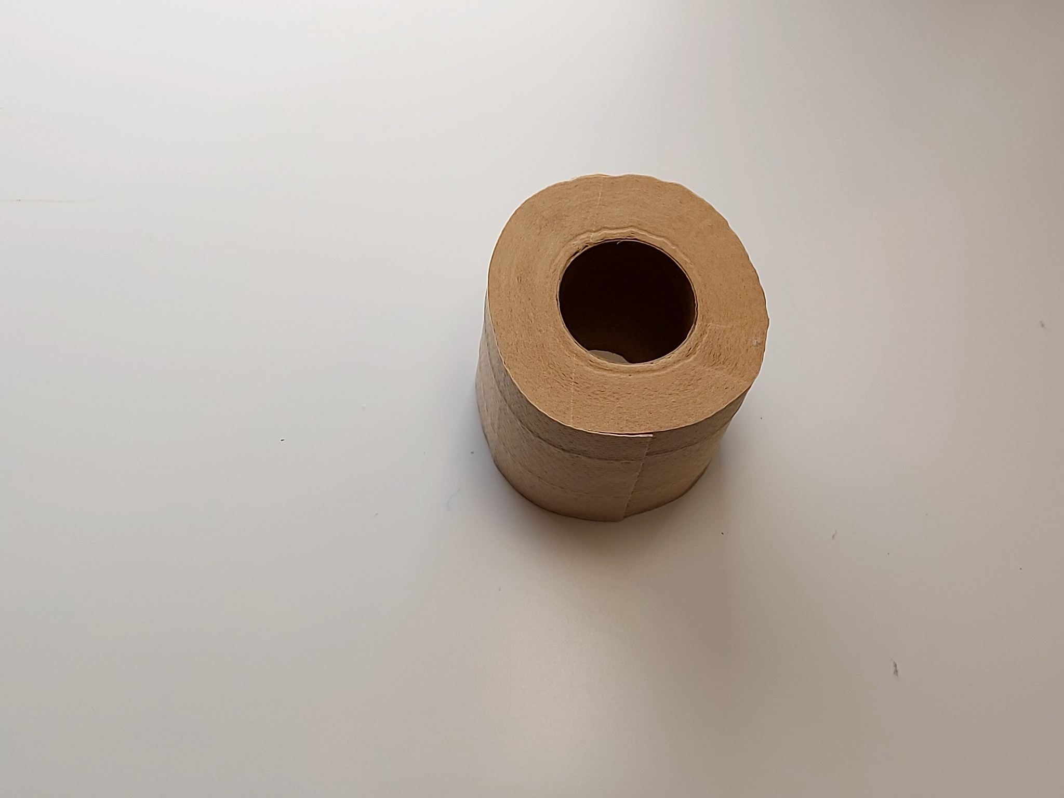
The relationship between circumference and diameter
Alex is exploring the relationship between the diameter and circumference of a circle in a practical way.
circumference
How large is the circumference of this toilet roll compared to its diameter?
diameter

Slide 27
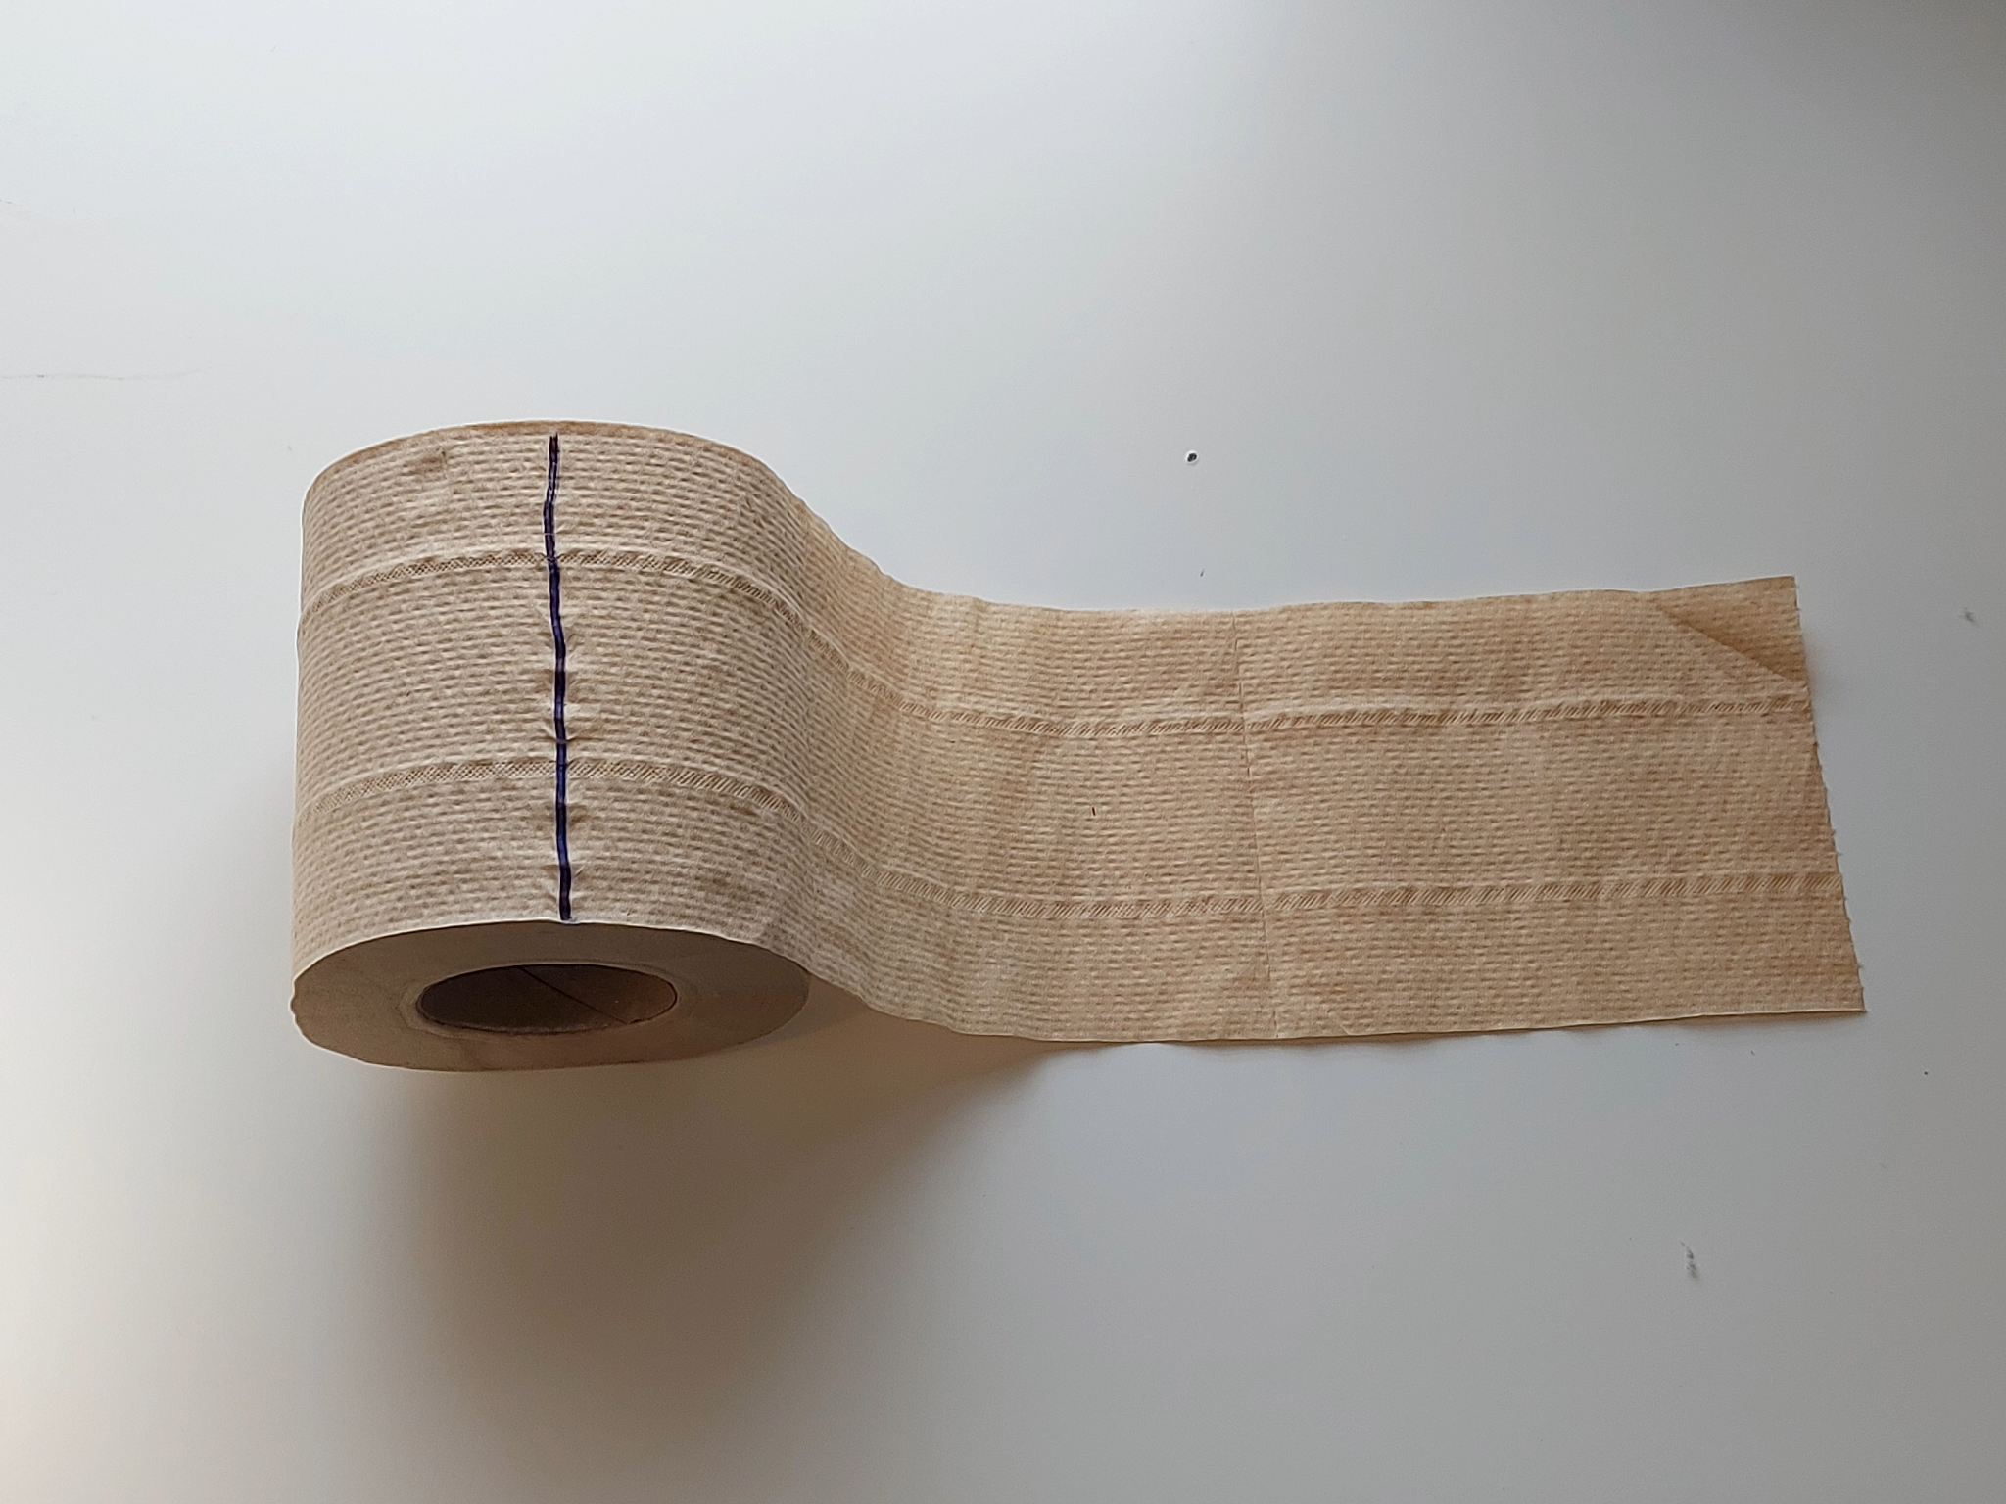
The relationship between circumference and diameter
Alex is exploring the relationship between the diameter and circumference of a circle in a practical way.
I will mark the end of the paper, unroll it up to the mark then I will cut along the mark.
circumference

Slide 28
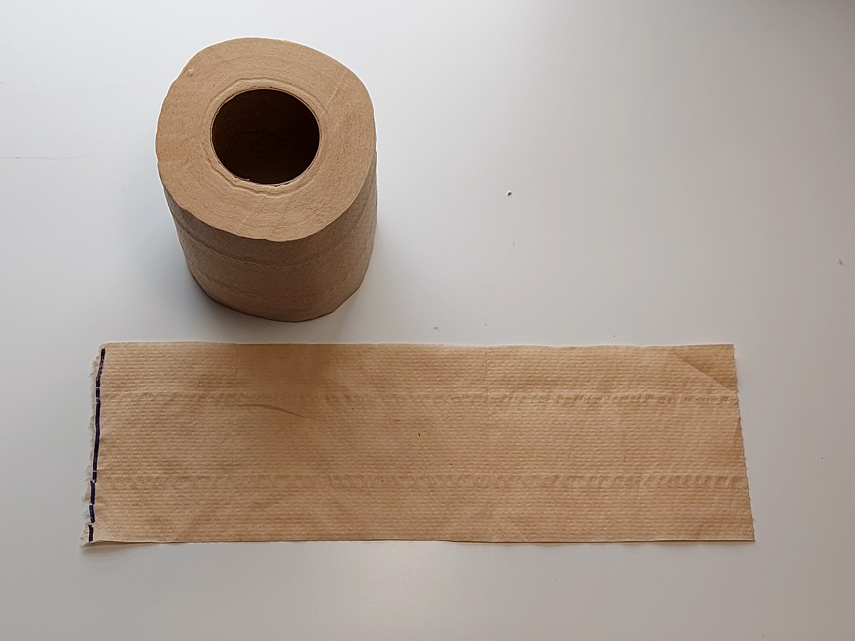
The relationship between circumference and diameter
Alex is exploring the relationship between the diameter and circumference of a circle in a practical way.
The length of the paper is approximately equal to the circumference of the roll.
circumference

Slide 29
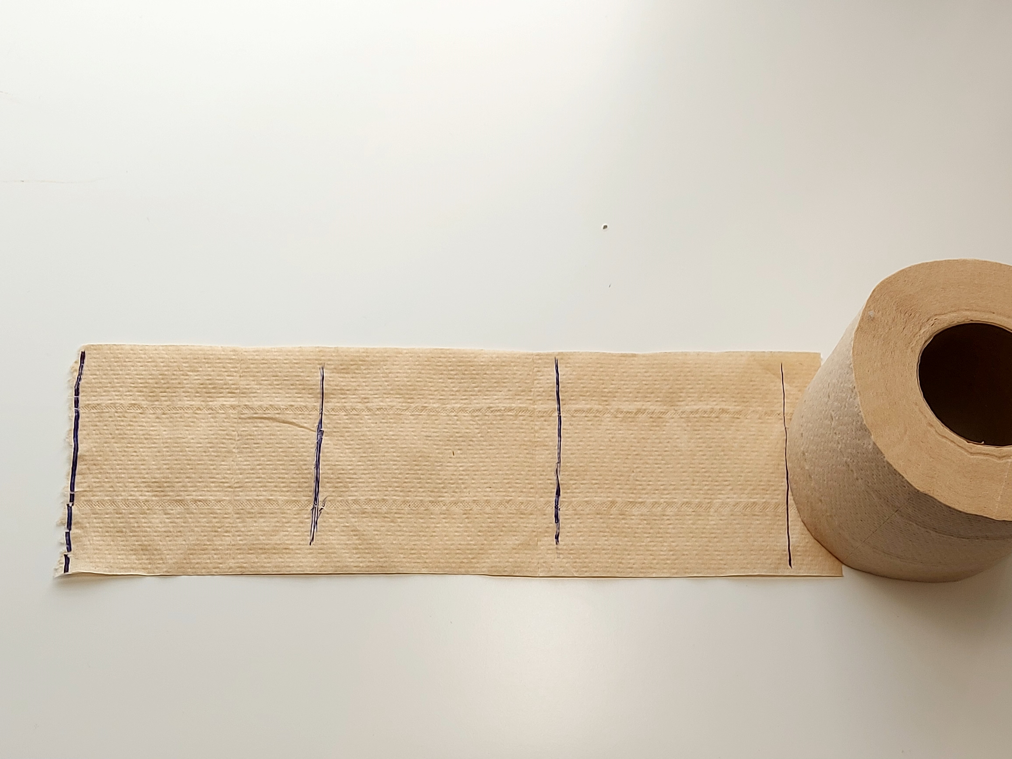
The relationship between circumference and diameter
Alex is exploring the relationship between the diameter and circumference of a circle in a practical way.
The circumference is approximately equal to three and a bit diameters.
diameter
diameter
diameter
circumference

Slide 30
The relationship between circumference and diameter
Izzy uses a computer to draw circles and measure their circumference and diameter.
diameter | circumference
15.70796327
12.56637061
1
3.141592654
9.424777961
6.283185307
2
6.283185307
3.141592654
1
2
3
4
3
9.424777961
5
4
12.56637061
5
15.70796327

Slide 31
The relationship between circumference and diameter
Izzy uses a computer to draw circles and measure their circumference and diameter.
The values for circumference in this table have been rounded.
diameter | circumference
1
3.141592654
The numbers that the computer showed had a lot more digits than these.
2
6.283185307
3
9.424777961
4
12.56637061
5
15.70796327

Slide 32
The relationship between circumference and diameter
Izzy uses a computer to draw circles and measure their circumference and diameter.
diameter | circumference
1
3.14159265…
The circumference looks like it is increasing by a constant difference.
2
6.28318530…
3
9.42477796…
4
12.5663706…
5
15.7079632…

Slide 33
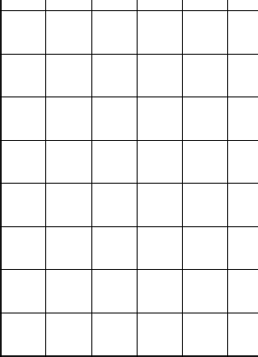
The relationship between circumference and diameter
Izzy plots her measurements on a graph to explore the relationship between diameter and circumference further.
diameter | circumference
14
3.14…
12
1
3.14159265…
+ 3.14…
10
3.14…
2
6.28318530…
circumference
8
+ 3.14…
3.14…
3
9.42477796…
6
+ 3.14…
4
3.14…
4
12.5663706…
+ 3.14…
2
5
15.7079632…
0
0
1
2
3
4
5
diameter

Slide 34
The relationship between circumference and diameter
The ratio between the diameter and circumference of a circle is always the same.
The circumference is always approximately 3.14… times the diameter.
diameter | circumference
× 3.14…
1
3.14159265…
× 3.14…
However, this number has more digits after 3.14…
2
6.28318530…
× 3.14…
3
9.42477796…
× 3.14…
The number of decimal places is infinite, meaning that the digits never end.
4
12.5663706…
× 3.14…
5
15.7079632…

Slide 35
The relationship between circumference and diameter
The ratio between the diameter and circumference is called π (“pi”).
π ≈ 3.1415926535 8979323846 2643383279 5028841971 6939937510 5820974944 5923078164 0628620899 8628034825 3421170679 8214808651 3282306647 0938446095 5058223172 5359408128 4811174502 8410270193 8521105559 6446229489 5493038196 4428810975 6659334461 2847564823 3786783165 2712019091 4564856692 3460348610 4543266482 1339360726 0249141273 7245870066 0631558817 4881520920 9628292540 9171536436 7892590360 0113305305 4882046652 1384146951 9415116094 3305727036 5759591953 0921861173 8193261179 3105118548 0744623799 6274956735…
π has infinite many digits and so cannot be written accurately in decimal form, but it is approximately 3.14159…
The most accurate way to write the number is as π.

Slide 36
The relationship between circumference and diameter
The ratio between the diameter and circumference is always the same for every circle.
The ratio differs depending on the size of the circle.
The circumference is always approximately 3.14 times the length of the diameter.

Slide 37
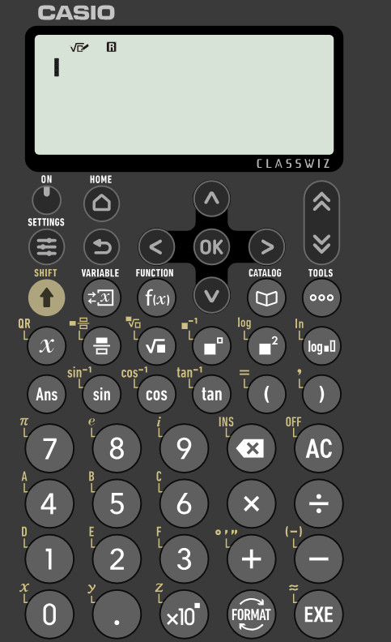


The relationship between circumference and diameter
Scientific calculators have a π button so can perform calculations with π accurately.
On this calculator the π symbol is above the 7 button.
shift button
So, you need press the shift button before pressing the 7 button to enter π.
π button

Slide 38
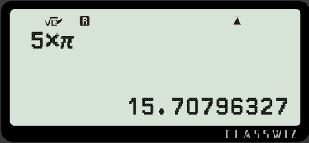
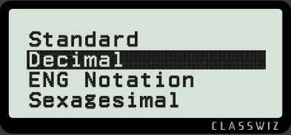
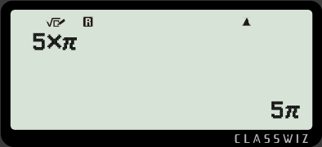
The relationship between circumference and diameter
When typing a calculation using the π button, the calculator will often give an answer that is in terms of π.
Calculators can convert answers from being in terms of π to decimals.
On this calculator, you can do this by pressing the format button and then selecting decimal.
format button

Slide 39
The relationship between circumference and diameter
The diameter of the circle is 20 cm. Find the circumference.
× π
diameter : circumference
× π
20 cm : cm
20 cm
circumference = 20 × π =
20π cm
≈ 62.8 cm
The most accurate way to write the solution is in terms of π.
To write it as a decimal would require rounding it to an appropriate degree of accuracy (e.g. 3 significant figures).

Slide 40
The relationship between circumference and diameter
The circumference of the circle is 20 cm. Find the diameter. Give your answer to 2 decimal places.
× π
20 cm
diameter : circumference
÷ π
cm : 20 cm
÷ π
diameter = 20 ÷ π
≈ 6.37 cm

Slide 41
The relationship between circumference and diameter
The diameter of the circle is 12 cm. Find the circumference. Give your answer to 1 decimal place.
12 cm
12 × π ≈ 37.7 cm

Slide 42
The relationship between circumference and diameter
1) Fill in the blanks in the table.
radius | 0.5 | 1 |  | 5 |  | 50
diameter | 1 | 2 | 6
circumference | π |  |  | 10π | 24π
2) Find the missing length in each circle, giving your answer to 3 significant figures.
a)
diameter : circumference
b)
diameter : circumference
11 cm
11 cm : cm
mm : 80 mm
80 mm

Slide 43
The relationship between circumference and diameter
1) Fill in the blanks in the table.
radius | 0.5 | 1 |  | 5 |  | 50
diameter | 1 | 2 | 6
circumference | π |  |  | 10π | 24π
3
12
10
24
100
2π
6π
100π
2) Find the missing length in each circle, giving your answer to 3 significant figures.
a)
diameter : circumference
b)
diameter : circumference
11 cm
34.6
cm
25.5
mm : 80 mm
11 cm :
80 mm

Slide 44
Multiplicative relationships in circles
The diameter of a circle is double the length of the radius. The length of the radius is half of the diameter.
The ratio between the diameter and circumference of a circle is always the same.
The ratio between the diameter and circumference is called π (“pi”).
π cannot be written accurately in decimal form, but it is approximately 3.14159…
The circumference of a circle can be calculated using the formula C = πd or C = 2πr

Slide 45

© Oak National Academy 2023.
Produced in partnership with Mathematics in Education and Industry.
Licensed on the Open Government Licence v3.0, except where otherwise stated. See Oak terms and conditions.

